Slide 1
Case Study : Financial Consumer Complaints – Bank of America
Data Analysis
By Yuvraj Pawar

Slide 2
Problem Statement :
Bank of America receives thousands of consumer complaints related to various financial products and services. Understanding the nature, timing, and resolution of these complaints is crucial for improving customer satisfaction and regulatory compliance. However, the volume and complexity of data make it challenging to extract actionable insights. This case study aims to uncover patterns in complaint types, timeliness, and resolution outcomes.

Slide 3
Objectives :
Complaint Volume Analysis – Track monthly and yearly complaint trends to identify periods of increased consumer dissatisfaction.
Product & Issue Insights – Determine which financial products and issues generate the highest volume of complaints.
Response Assessment – Analyze how complaints are resolved, including types of responses and whether they were provided in a timely manner.
Channel Effectiveness – Understand which submission channels (e.g., web, phone) are most commonly used and their impact on resolution.

Slide 4
Dataset Overview /Key Features of the Dataset :
Dataset Overview : This dataset includes (62516) consumer complaints submitted to the Consumer Financial Protection Bureau (CFPB), focusing on issues reported against Bank of America. It captures details such as complaint date, product type, issue, submission channel, company response, and whether the response was timely.
Key Features of the Dataset
Complaint Details - Includes complaint ID, date received, and consumer's description .
Product & Issue Information - Captures the type of financial product, specific sub-product, issue, and sub-issue.
Submission & Location - Tracks how complaints were submitted (e.g., web, phone) and the consumer’s location (state).
Company Response Metrics - Shows how the company responded (e.g., explanation, relief), whether it was timely, and if the consumer disputed it.

Slide 5
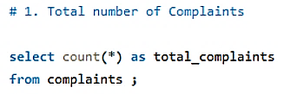

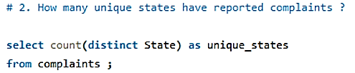

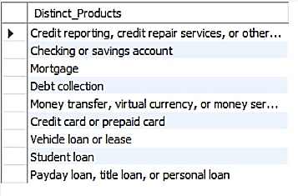
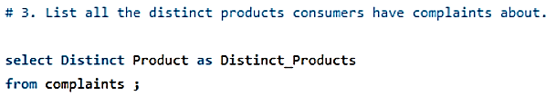

Slide 6
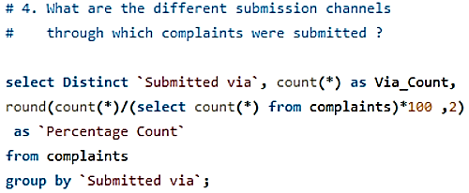
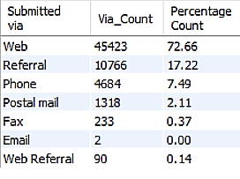
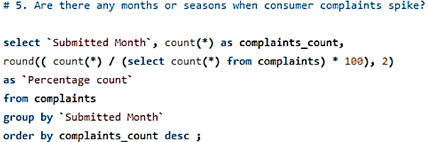
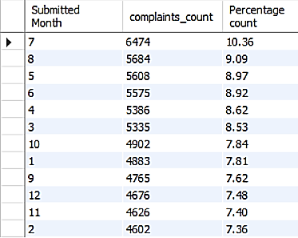
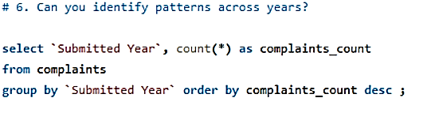
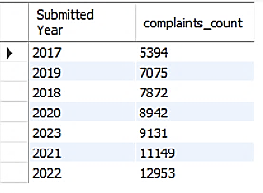

Slide 7
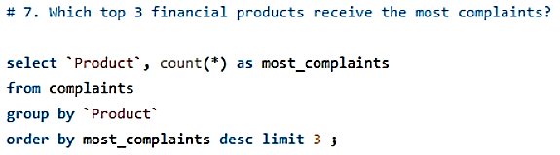
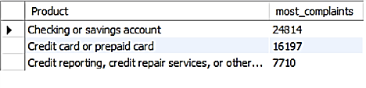
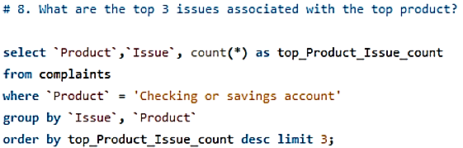
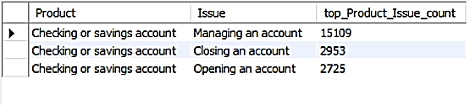
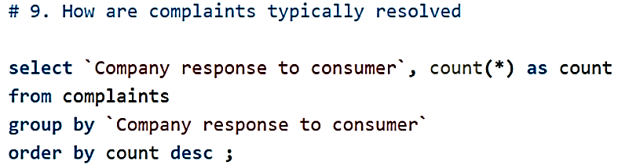
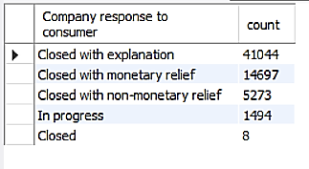

Slide 8
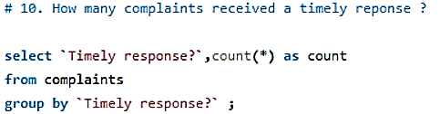
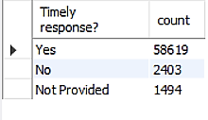
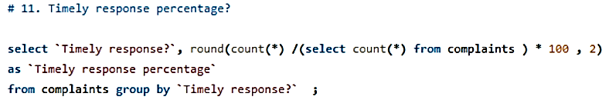
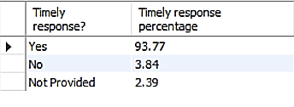
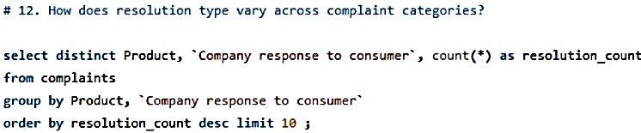
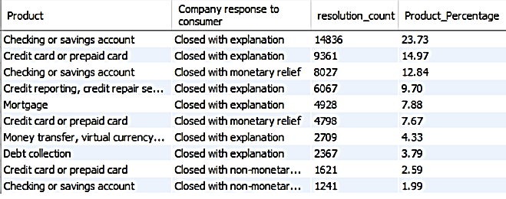

Slide 9
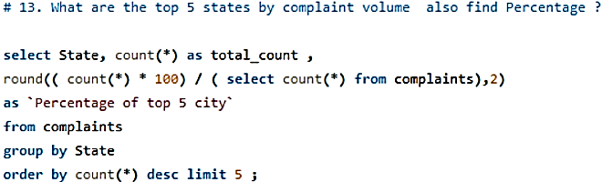
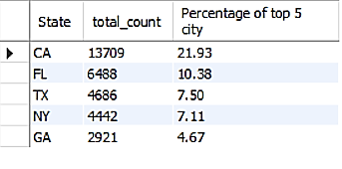
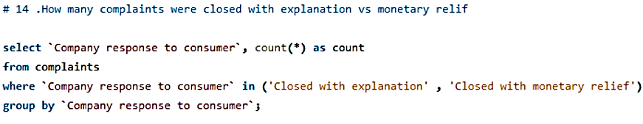
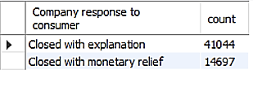
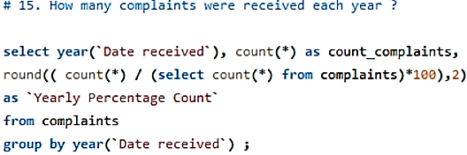
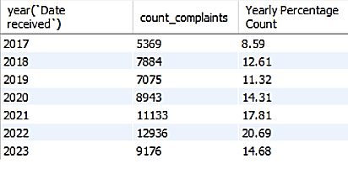

Slide 10
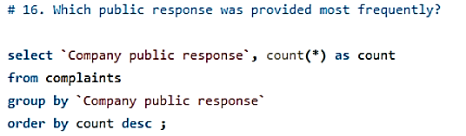
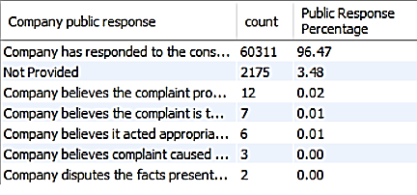
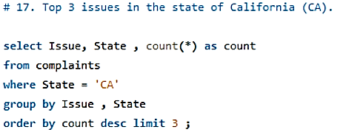
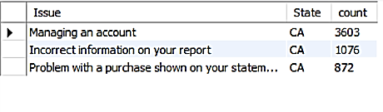
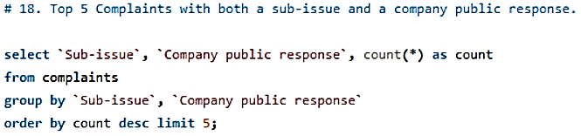
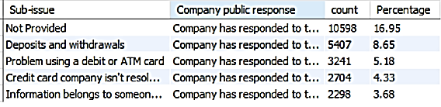

Slide 11
Final Insights :
Final Insights Total Complaints: 62,516 (May 2017 – Dec 2023)
Trend: Growth till 2020, then stable in 2021–2023
Seasonal Spikes: Peaks in July & December
Products: Most complaints → Credit Reporting, Mortgage, Credit Card
Issues: Top = Incorrect info on credit report; also loan servicing, billing disputes
Channels: Web dominates; Phone steady; Email/Post very low
States: Highest → California, Texas, Florida, New York, Georgia
Company Response: Mostly Closed with explanation; relief rare
Public Response: Most frequent → “Acted appropriately as authorized by contract/law”
Timeliness: ~90% timely; delays in credit card & loan complaints

Slide 12
ConCLUSION:
The consumer complaints dataset reveals that most issues are centered around products like credit reporting, mortgages, and debt collection. The majority of complaints were resolved with a "Closed with explanation" status, indicating limited financial compensation. While companies generally respond in a timely manner, certain product types show higher rates of delays. The web remains the dominant submission channel, reflecting a shift toward digital interaction. Overall, the data highlights key areas for improving transparency, response quality, and customer service in the financial sector.

